Slide 1
Euphona – The Music Streaming App Software Architecture and Development
Jhesta Narasimhamurthy (11013658)
SRH Hochschule Heidelberg

Slide 2
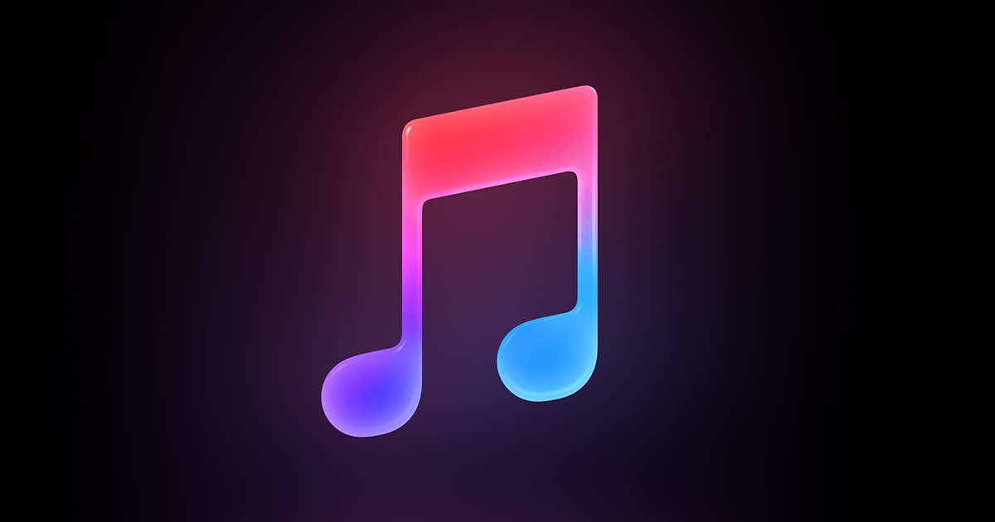
Introduction
Euphona is a music streaming application that enables users to listen to different genres of music.
The user can register on the website and login as a user to stream songs and listen to them.

Slide 3
Technologies used
Database used - MongoDB Atlas
Front end – React JS
Back end – JSON REST API
NODE JS, EXPRESS JS, PASSPORT AUTHENTICATION

Slide 4
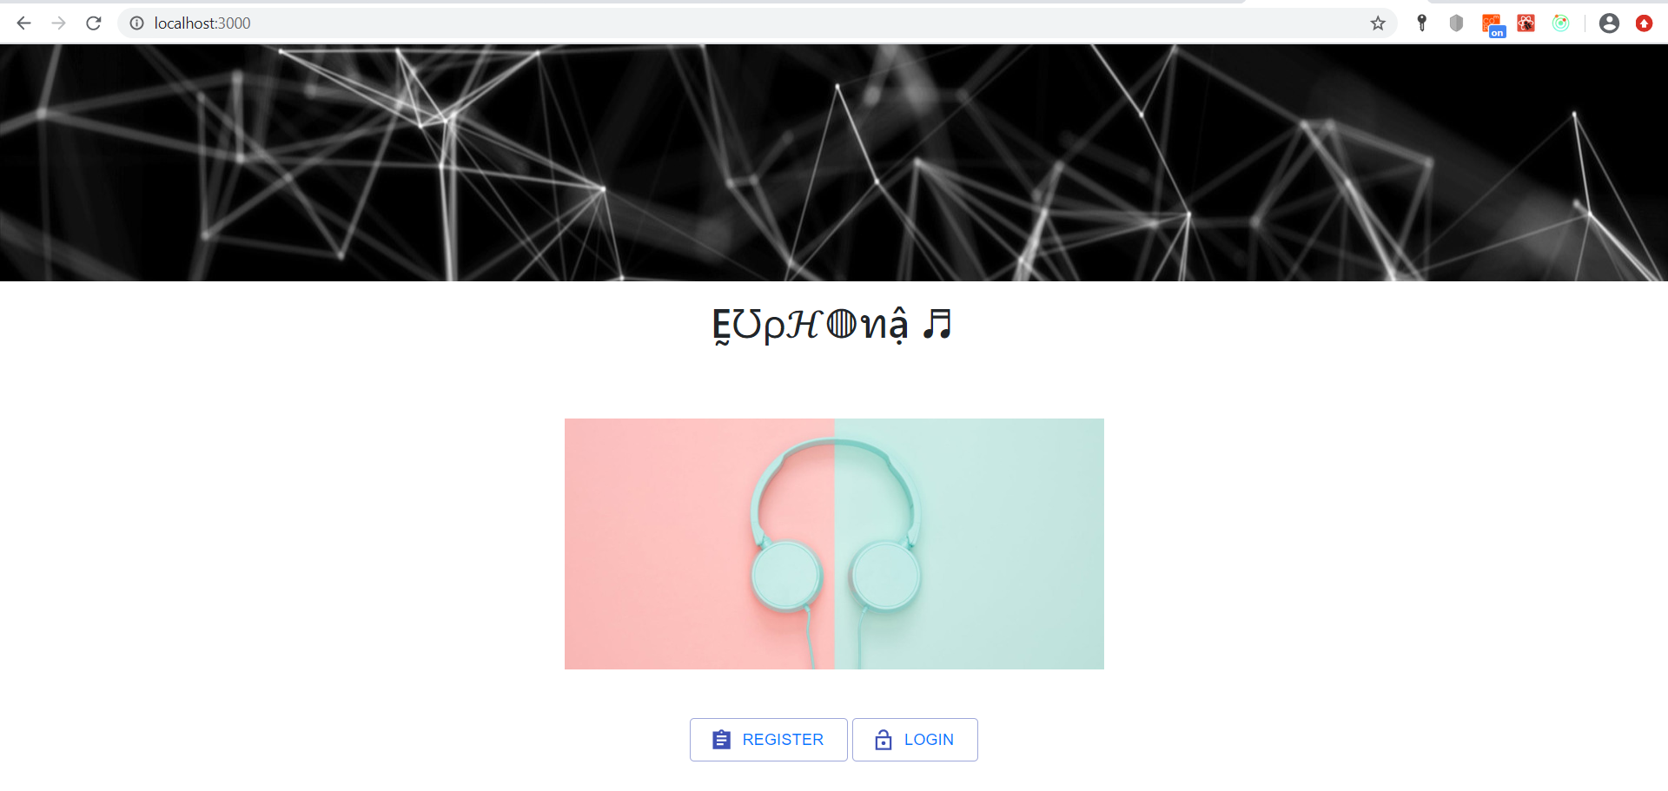
Home Page

Slide 5
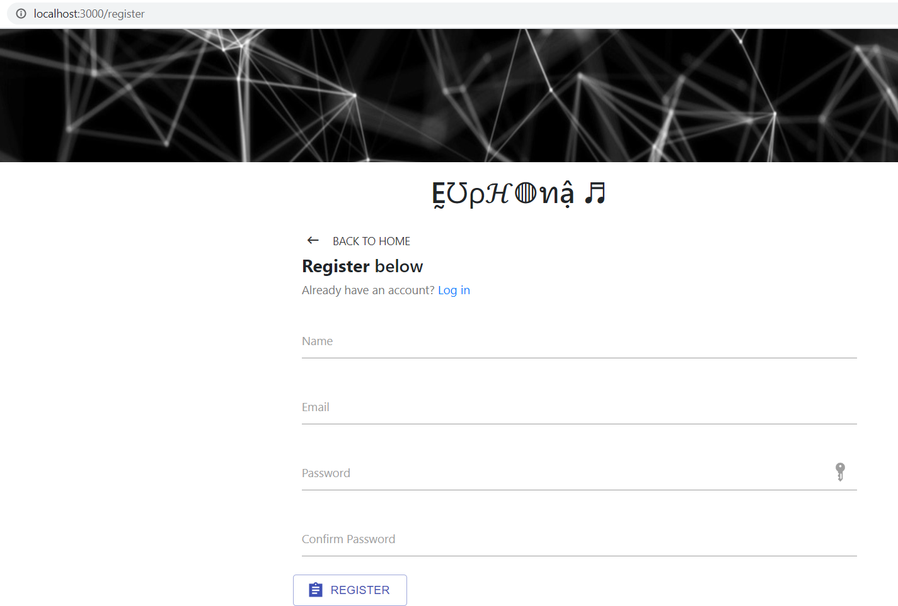
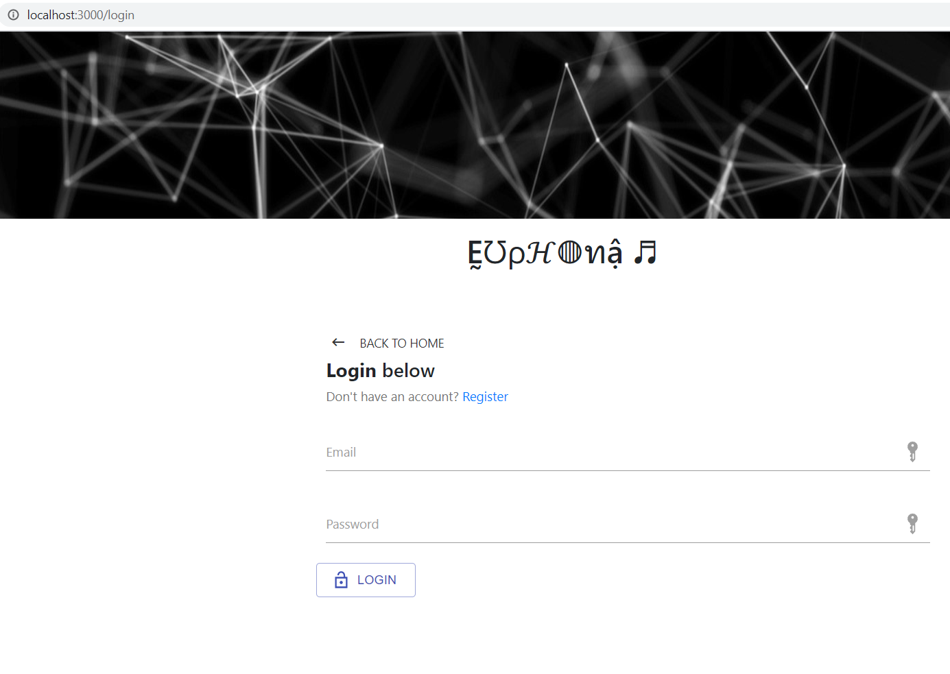
Register/Sign in pages

Slide 6
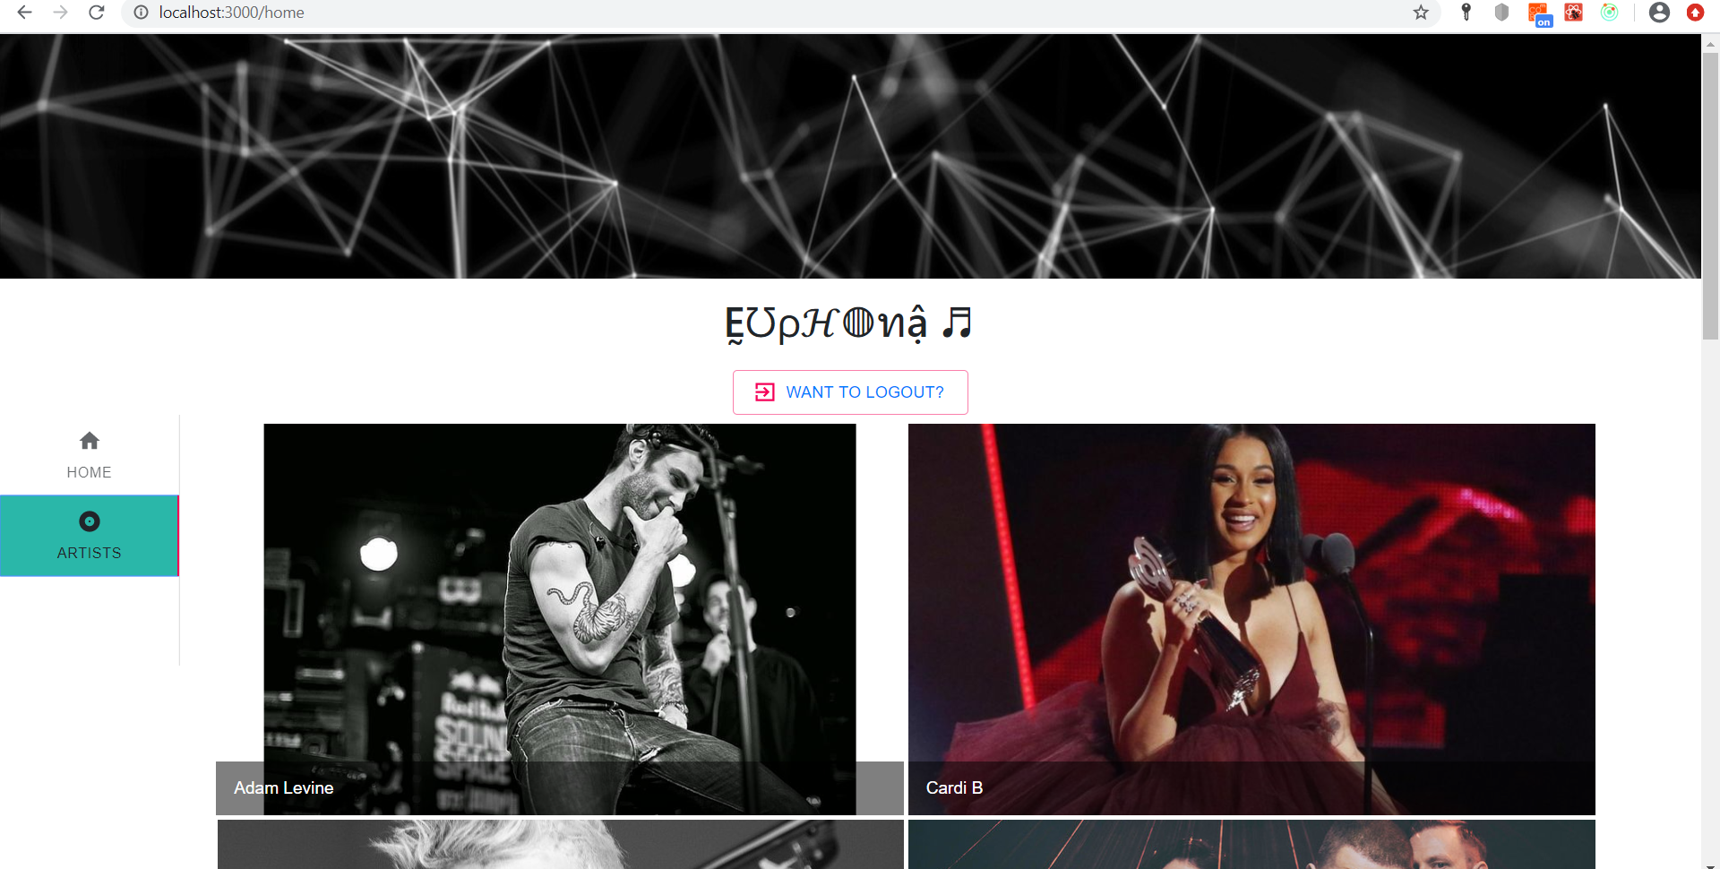
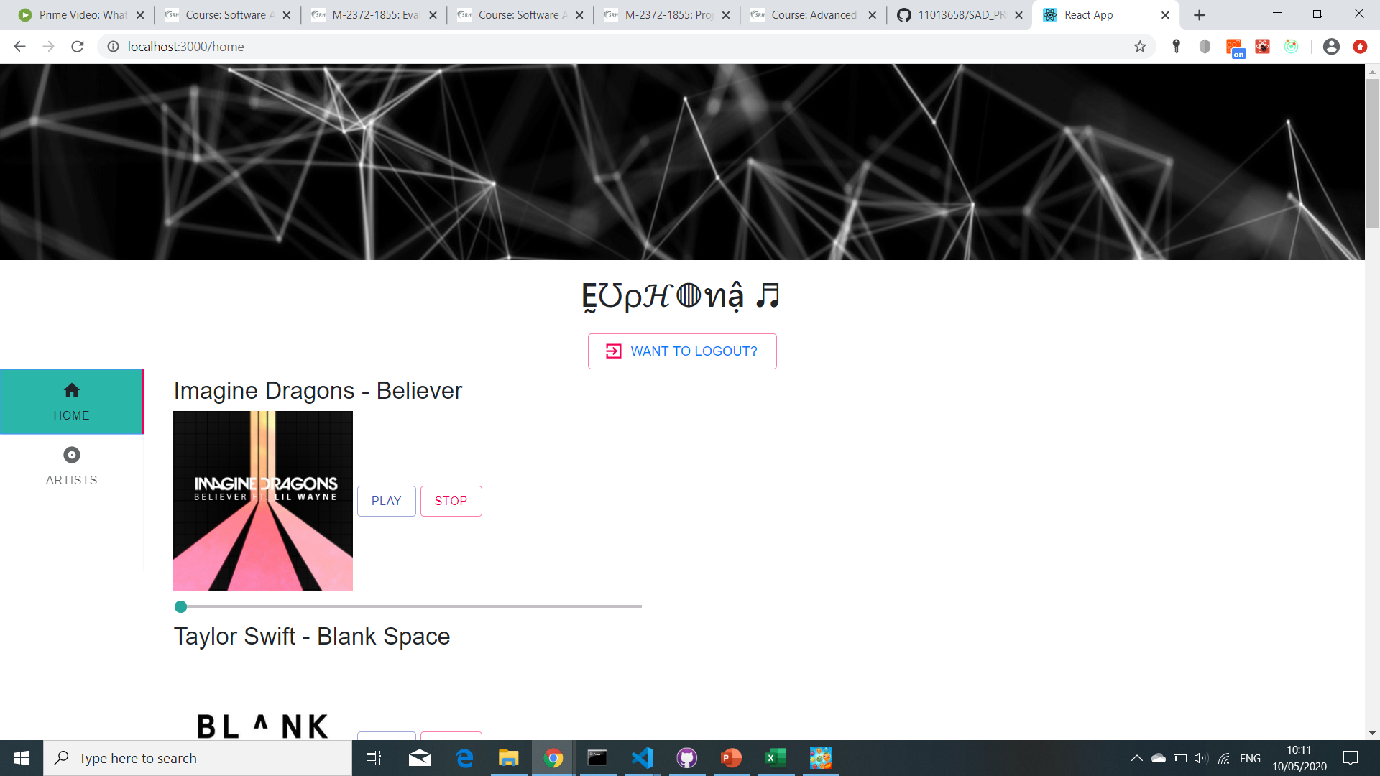
Music Streaming Pages

Slide 7
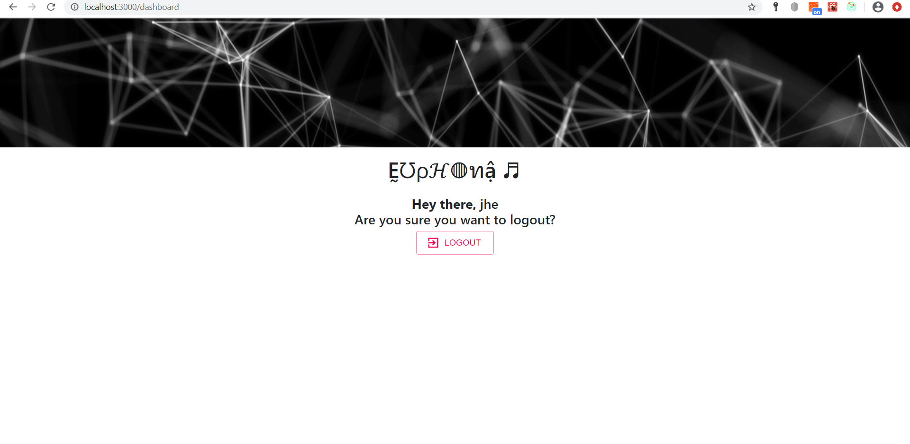
Logout Page

Slide 8
Danke!

